Slide 1
What is IT?

Slide 2
Introduction
The definition, components, and scope of Information Technology

Slide 3
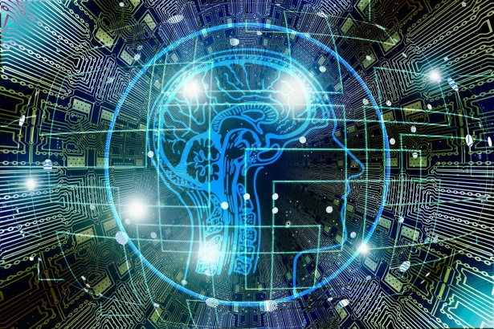
What is Information Technology?
Information Technology (IT) refers to the use of computers, software, networks, and electronic devices to store, process, transmit, and manage data and information.
It encompasses a wide range of technologies and practices that enable the acquisition, storage, manipulation, and dissemination of information.

Slide 4
The Components of Information Technology
Hardware: Physical devices such as computers, servers, network equipment, and mobile devices that form the IT infrastructure.
Software: Programs and applications that run on hardware to perform various tasks, from simple calculations to complex data analysis.
People: Skilled professionals who design, develop, maintain, and support IT systems.
Networks: The interconnected systems that facilitate communication and data exchange between devices and users.
Data: Raw facts and figures that are collected, stored, and processed by IT systems.

Slide 5
The Scope of Information Technology
IT plays a crucial role in various aspects of an organization, including:
Business Operations: Streamlining processes, automating tasks, and improving productivity.
Data Management: Storing, analyzing, and safeguarding large volumes of data for better decision-making.
Cybersecurity: Protecting against cyber threats and ensuring data privacy and compliance.
Digital Transformation: Embracing digital technologies to stay competitive and adapt to changing market dynamics.
Customer Service: Enhancing customer experiences through digital channels and personalized interactions.

Slide 6
Thank you!
Q & A

